Slide 1

Programming Ruby Share
2011.5.16
Augmentum
™

Slide 2
Main Directory
What's Ruby?
Basic Syntax
Objects-Oriented
Accessibility of object,method,or module
Module and Mix-in
Special use(string,array etc.)
How to read ruby programming
Notes:
The idea of a "connection pool" is a set of open connections to a database server. Web servers have to manage sets of clients and connections. File descriptors provide another example of a set in the operating system.
Some real-world examples of sets include the following:
* The set of uppercase letters 'A' through 'Z'
* The set of reserved Java programming language keywords {'import', 'class', 'public', 'protected'...}
* A set of people (friends, employees, clients, ...)
* The set of records returned by a database query
* The set of Component objects in a Container
A map is a special kind of set. It is a set of pairs, each pair representing a one-directional "mapping" from one element to another. Some examples of maps are:
* The map of IP addresses to domain names (DNS)
* A map from keys to database records
* A dictionary (words mapped to meanings)

Slide 3
What's Ruby?
Ruby is a programming language
> Ruby is written by Yukihiro Matsumoto,he is Japanese,Ruby is scripting language of object-oriented,and it is easy to learn
Features of Ruby
> Simple
Interpreted language,so before running it doesn't must be compiled
Variable have no type,and variable doesn't be defined before using
No Memory management,the systems provide GC handing
> Pure object-oriented Language
All is object
Ruby have some features of the object,for example:Encapsulation,Inheritance,Polymorphism,
Ruby have special features,for example Module,Mixin
Notes:
The idea of a "connection pool" is a set of open connections to a database server. Web servers have to manage sets of clients and connections. File descriptors provide another example of a set in the operating system.
Some real-world examples of sets include the following:
* The set of uppercase letters 'A' through 'Z'
* The set of reserved Java programming language keywords {'import', 'class', 'public', 'protected'...}
* A set of people (friends, employees, clients, ...)
* The set of records returned by a database query
* The set of Component objects in a Container
A map is a special kind of set. It is a set of pairs, each pair representing a one-directional "mapping" from one element to another. Some examples of maps are:
* The map of IP addresses to domain names (DNS)
* A map from keys to database records
* A dictionary (words mapped to meanings)

Slide 4
What's Ruby
> Scripting Language
Interpreted
Have Strong word processing and Regular Expressions
Direct access to the OS. So it is possible which writing Systems programs by Ruby
>Other
Support many of Long Integer. If memory is enough,ruby can operator big number to calculate
With exception handling likes exception of JAVA
Dynamic loading . Ruby May redefine itself when program is running . The Inheritance of class will be changed when program is running.
Thread,Ruby have thread concepts now and Ruby2.0 is supported local threads.

Slide 5
Basic Syntax
Comment
> # One line comment using “#”
> =begin comments =end More lines comment using “=begin comments =end”

Slide 6
Basic Syntax
Separator
> ; Semicolon used to separate multiple statements in a row
> () Brackets used to increased priority,Accommodate the parameter list when method was defined .
> Space used to separate character, instead of brackets where omission ”()”
> , Comma used to separate multiple parameters
> . Point used to separate method of object
>:: Two colons used to domain character,used to separate constant of module(class)

Slide 7
Basic Syntax
Key Words and Operator
> key word module,class,def,undef,defined?,if,then,else,elsif,case,when,unless,for,in,while,until,next,break,do,redo,retry,yield,not,and,or,true,false ,nil,rescue,ensure,super,self,begin/end,BEGIN,END,__FILE__,__LINE__,return,alias
> Operator
Operator including, bit operators, digital operators, comparison operators, assignment operator
Bit operators for example:_{>>,<<,&,^|,!,~,+,-}
Digital operators for example:+,-,*,/,%,**
Logic operators for example:<=,<,>,>=,<=>,==,===,=~,!=,!~,&&,||,or,and,not
Assignment operator for example:=,%=,/=,+=,|=,&=,>>=,<<=,*=,&&=,||=,**=,~=

Slide 8
Basic Syntax
Scope of the variable name and logo
> Keyword, can not be used as a constant, variable, method, class or module name
Data Type
> Number,String,Array,Hash,Range,Regular etc.
Number like this 1,1.0
String like this “abc”
Array like this arr3=['4 ','5 ','6 ']
Range like this 1..9
Regular like this =~/b/,!~/a/
Hash

Slide 9
Basic Syntax
Assignment statement
> Used equal sign to assignment
a = 1 ；b = 2 + 3 #a=1 ,b=5
a ,b = b ,a #a=5 ,b=1
a = b = 1 + 2 + 3 #a=6 ,b=6
a = (b = 1 + 2) + 3 #a=6 ,b=3
x = 0 #x=0
a,b,c = x, (x+1), (x+2) #a=0 ,b=1,c=2

Slide 10
Basic Syntax
Conditional operator
==, != used to compare value of two objects,return true or false
eql? used to compare value and datatype of two objects,return true or false.
equal? used to compare address of memory,return true or false
<=> used to Comparison of two objects (ascii),greater than,equal to,less than, return 1,0, -1
=== used to the right of the object is within the range on the left, return true, false
=~ (Match) used to compare whether a regular expression, return mode in the string are matched to the position, otherwise return nil
!~ (Doesn't Match)Assertion does not meet a regular expression, return true, false
<= < > >= return true or false

Slide 11
Basic Syntax
Conditional statement
>single line if statement
if condition then statement1;statement 2;statement...end
(statement1;statement2;statement...) if condition
>multi-line if statement
if condition1
statement1;statement2;statement...
elsif condition2
statement1;statement2;statement...
else
statement1;statement2;statement...
end

Slide 12
Basic Syntax
Conditional statement
>unless
unless condition = if not condition
unless condition then statement1;statement2;statement...end
(statement1;statement2;statement...) unless condition
>case
case object1
when possibility1
statement1;statement2;statement...
when possibility2
statement1;statement2;statement...
when possibility…
statement1;statement2;statement...
else
statement1;statement2;statement...
end

Slide 13
Basic Syntax
Cycle statement
>while (when......)cycle
while condition
statement1;statement2;statement...
end
(statement1;statement2;statement...) while condition
>until cycle
until condition
statement1;statement2;statement...
end
(statement1;statement2;statement...) until condition

Slide 14
Basic Syntax
Loop Statements
>for...in Loop
for variable in object
statement1; statement2 ;statement…
end
>other key word of Loop
break,Jump out of current loop
next, Ignore left statement of this time ,start next loop
redo,Restart the whole loop from first time

Slide 15
Basic Syntax
Some special method of recycling
>number.times{statement1;statement2;statement...}
>little number.upto(big number){|i| statement1;statement2;statement...}
>bignumber.downto(little number){|i| statement1;statement2;statement...}
>(1..N).each{|i| statement1;statement2;statement...}
>startNum.step(endNum,stepnum){|i| statement1;statement2;statement...}

Slide 16
Basic Syntax
Exception
>begin/end rescue\ensure
begin
statements
rescue ExceptionTypeClass1
statements
retry # retry begin programing
rescue ExceptionTypeClass2
$! # information that exception
$@ # that the code that appears abnormal position
raise # throw exception
ensure
#sure to do something,eg:close db connection,colse file etc
end
# specify the type of exception capturing default value is StandardException

Slide 17
Object-Oriented
Class
A collection of some properties and behaves is called class
Object
An instance of a class called Object

Slide 18
Object-Oriented
Encapsulation
Information hiding . Telling the user how to use, users do not care about the specific code.
Inheritance
Attributes or characteristics of the inheritance, to avoid redundancy of information
Polymorphism
The objects inherited the parent,but each object has some different behaviors . So this situation needs to be expressed polymorphism. Ruby language has only override.

Slide 19
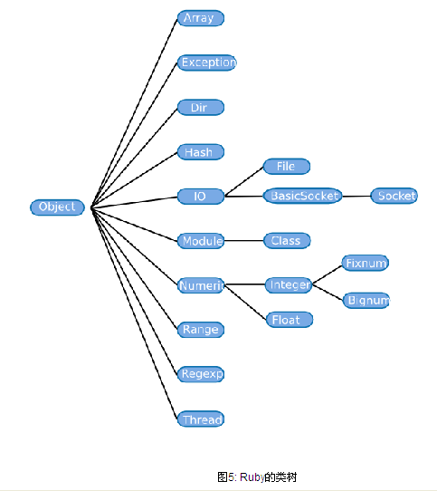
Object-Oriented
Class Tree of Ruby

Slide 20
_{Accessibility}
Ruby provides three levels of method accessibility
public protected private
>public,All your methods are public unless you specify otherwise. When a method is public, it is available to be used by the world outside the object in whose class it is defined
>protected,When a method is private, it can only be used by other methods inside the object in whose class it is defined.
>private,When a method is private, it can only be used by other methods inside the object in whose class it is defined.

Slide 21
Module and Mix-in
Features of Module
>Ruby module is very similar to the class,Module is function related code
>Module can not have a physical,Module can not have subclasses,Modules defined by the module ... end
>Mix-in,To achieve a similar function of multiple inheritance.
How to use Module
include or extend . include method for all objects of a class contains a module; extend method for a class of an object containsmodule.
class A
include ***Module
end
aClass.extend(***Module)

Slide 22
Module and Mix-in
Mix-in
Ruby is also the single inheritance, through the Mix-in modules, to achieve the advantages of multiple inheritance
For example: Class student inheritance the class person,but the class student need method of sqrt in module of Me. To achieve the above results,we can like this:
class Student < Person
include Me
end
Another example: Class student inheritance the class person,but the object of class student need method of sqrt in module of Me. To achieve the above results,we can like this:
aStudent=Student.new
aStudent.extend(Me)

Slide 23
Ruby file load and require
Mix-in
Ruby is also the single inheritance, through the Mix-in modules, to achieve the advantages of multiple inheritance
For example: Class student inheritance the class person,but the class student need method of sqrt in module of Me. To achieve the above results,we can like this:
class Student < Person
include Me
end
Another example: Class student inheritance the class person,but the object of class student need method of sqrt in module of Me. To achieve the above results,we can like this:
aStudent=Student.new
aStudent.extend(Me)

Slide 24
Special use(String)
Create String
Characters with special symbols caused;The special symbols include quotes(“”),single quote(''),%q or %Q(! !; / /; < >; ( ); [ ];{ })
Operator String
plus(+),<<,*,[i..n]
Special String
\n,line character ;\t tab character ;\ escape character;
Expression in String
def hello(name)
" Welcome, #{name} !"
end

Slide 25
Special use(Array)
Create Array
Create an array variable can use the following methods:
arr1=[],arr2=Array.new,arr3=['4','5',6]
Visit Array elements
The index of the array starting from 0 until the length of the array minus 1; negative numbers at the end of the beginning of the array index; with a pair of numbers to index the array, the first number indicates the start position, the second number indicates the element from the beginning onwards Number of.

Slide 26
Special use(Array)
Add,delete array elements
arr.clear #clear arr
arr.shift #delete first element
arr.pop #delete last element
arr.delete("b") #delete all of element of "b"
arr.delete(["a","b","c"] ) #delete the elements of ["a","b","c"]
arr.delete_at(3) #delete index of three element
arr.insert(3,"d") #insert element of "d" before index is three
arr.push("b" ) #append element of "b" at the last
arr<<"f"<<2 #append element of "f" and element of 2
Array operation

Slide 27
Special use(Array)
Array operation
+,arr1 + arr2,Combined array “arr1” and “arr2”
-,arr1 – arr2,Remove elements that include in the “arr2” from an array “arr1”
* arr1*2,Repead elements of array “arr1” two times
| arr1|arr2,Together the two elements of the array, just take a duplicate.
& arr1&arr2,The array elements in both “arr1” and “arr2”
sort,arr1.sort Sort the elements in array “arr1”
reverse,arr1.reverse Invert elements in array “arr1”

Slide 28
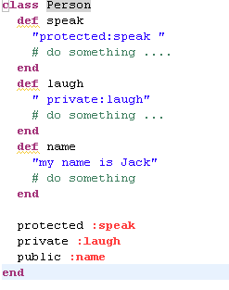
How to read Ruby Programming
Defined Class

Slide 29
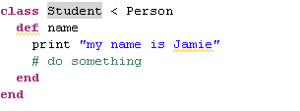
How to read Ruby Programming
new Object
Inheritance

Slide 30
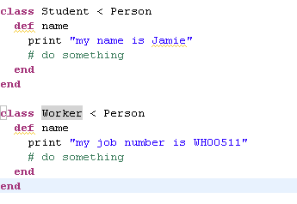
How to read Ruby Programming
Polymorphism
The class of Student and Worker inheritance parent class of person,but they override name method. This is polymorphism

Slide 31
Reference
<Programming Ruby,Second Edition>
<Ruby 语言入门教程>

